Slide 1
Oracle 12c: SQL
Chapter 11
Group Functions
©2016. Cengage Learning. All rights reserved.

Slide 2
Objectives
Differentiate between single-row and multiple-row functions
Use the SUM and AVG functions for numeric calculations
Use the COUNT function to return the number of records containing non-NULL values
Use COUNT(*) to include records containing NULL values
Use the MIN and MAX functions with nonnumeric fields
©2016. Cengage Learning. All rights reserved.

Slide 3
Objectives (continued)
Determine when to use the GROUP BY clause to group data
Identify when the HAVING clause should be used
List the order of precedence for evaluating WHERE, GROUP BY, and HAVING clauses
State the maximum depth for nesting group functions
Nest a group function inside of a single-row function
©2016. Cengage Learning. All rights reserved.

Slide 4
Objectives (continued)
Calculate the standard deviation and variance of a set of data, using the STDDEV and VARIANCE functions
Explain the concept of multidimensional analysis
Perform enhanced aggregation grouping with the GROUPING SETS, CUBE, and ROLLUP
Use composite columns and concatenated groupings in grouping operations
©2016. Cengage Learning. All rights reserved.

Slide 5
Group Functions
Return one result per group of rows processed
Are also called multiple-row and aggregate functions
All group functions ignore NULL values except COUNT(*)
Use DISTINCT to suppress duplicate values
©2016. Cengage Learning. All rights reserved.

Slide 6
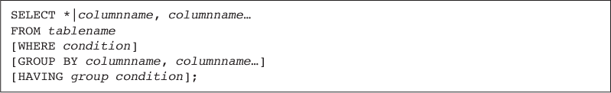
Added Clauses
©2016. Cengage Learning. All rights reserved.

Slide 7
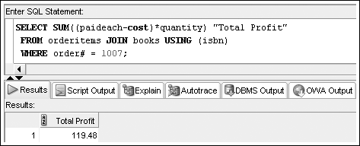
SUM Function
Calculates total amount stored in a numeric column for a group of rows

Slide 8
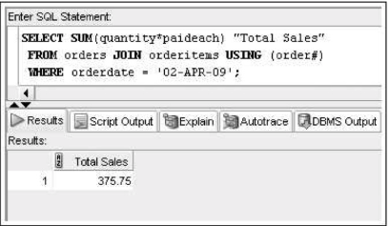
SUM Function

Slide 9
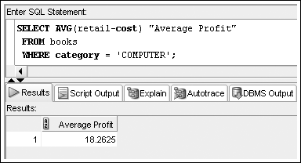
AVG Function
Calculates the average of numeric values in a specified column
©2016. Cengage Learning. All rights reserved.

Slide 10
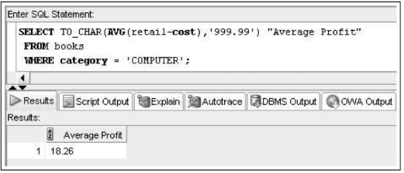
AVG Function
©2016. Cengage Learning. All rights reserved.

Slide 11
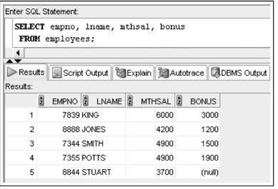
AVG Function
NULL values can be a problem when calculating averages
©2016. Cengage Learning. All rights reserved.

Slide 12
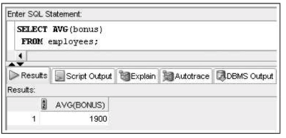
AVG Function
The calculation ignores the row containing a NULL
©2016. Cengage Learning. All rights reserved.

Slide 13
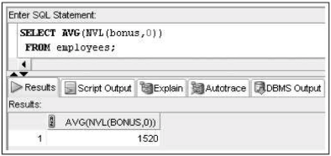
AVG Function
But what if the NULL value actually represents a bonus of zero, it must be included in the calculation. In this case, the NVL function (covered in Chapter 10) can be used to indicate that a NULL value should be treated as a zero.
©2016. Cengage Learning. All rights reserved.

Slide 14
COUNT Function
Two purposes
  Count non-NULL values
  Count total records, including those with NULL values
©2016. Cengage Learning. All rights reserved.

Slide 15
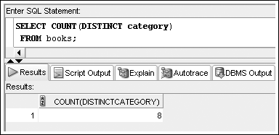
COUNT Function –
Non-NULL Values
Include column name in argument to count number of occurrences
©2016. Cengage Learning. All rights reserved.

Slide 16
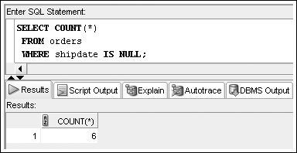
COUNT Function –
NULL Values
Include asterisk in argument to count number of rows
©2016. Cengage Learning. All rights reserved.

Slide 17
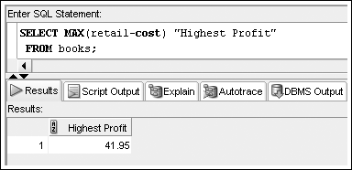
MAX Function
Returns largest value
©2016. Cengage Learning. All rights reserved.

Slide 18
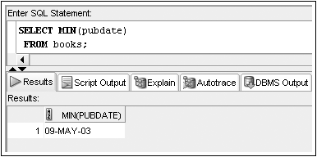
MIN Function
Returns the smallest value
©2016. Cengage Learning. All rights reserved.

Slide 19
Datatypes
The COUNT, MIN, and MAX functions can be used on values with character, numeric, and date datatypes
©2016. Cengage Learning. All rights reserved.

Slide 20
Grouping Data
GROUP BY clause
  Used to group data
  Must be used for any individual column in the SELECT clause with a group function
  Cannot reference column aliases
©2016. Cengage Learning. All rights reserved.

Slide 21
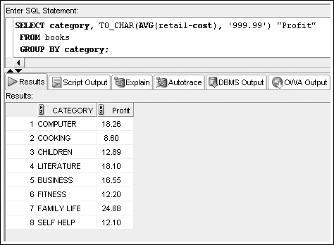
GROUP BY Example
Suppose the management of JustLee Books wants to know the average profit for each category of books.

Slide 22
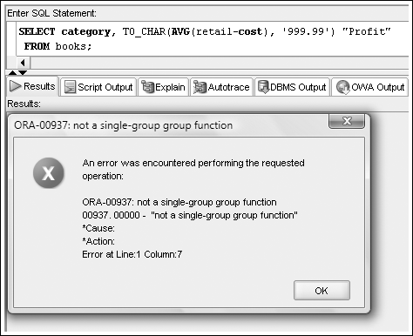
Common Error
A common error is missing a GROUP BY clause for nonaggregated columns in the SELECT clause
©2016. Cengage Learning. All rights reserved.

Slide 23
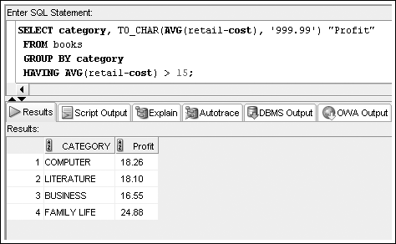
Restricting Aggregated Output
HAVING clause serves as the WHERE clause for grouped data
©2016. Cengage Learning. All rights reserved.

Slide 24
Restricting Aggregated Output (continued)
When included in the same SELECT statement, the clauses are evaluated in the order of:
  WHERE
  GROUP BY
  HAVING
©2016. Cengage Learning. All rights reserved.

Slide 25
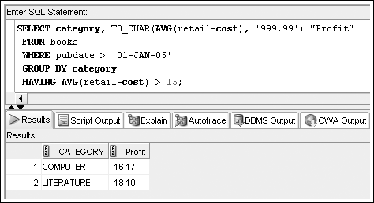
Restricting Aggregated Output (continued)
©2016. Cengage Learning. All rights reserved.

Slide 26
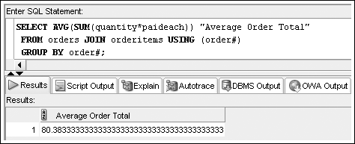
Nesting Functions
Inner function is resolved first
Maximum nesting depth: 2
©2016. Cengage Learning. All rights reserved.

Slide 27
Statistical Group Functions
Based on normal distribution
Includes:
  STDDEV
  VARIANCE
©2016. Cengage Learning. All rights reserved.

Slide 28
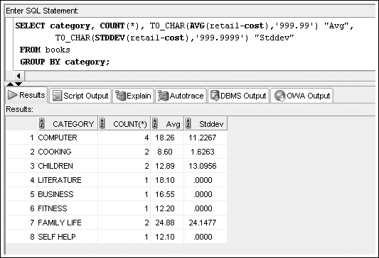
STDDEV Function
©2016. Cengage Learning. All rights reserved.

Slide 29
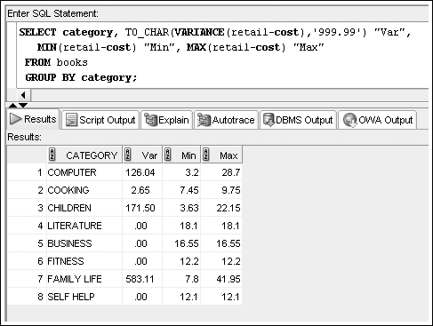
VARIANCE Function
Determines data dispersion within a group
©2016. Cengage Learning. All rights reserved.

Slide 30
Enhanced Aggregation for Reporting
Oracle provides extensions to the GROUP BY clause, which allow both aggregation across multiple dimensions or the generation of increasing levels of subtotals with a single SELECT statement
A dimension is a term used to describe any category used in analyzing data, such as time, geography, and product line
Each dimension could contain various levels of aggregation; for example, the time dimension may include aggregation by month, quarter, and year
©2016. Cengage Learning. All rights reserved.

Slide 31
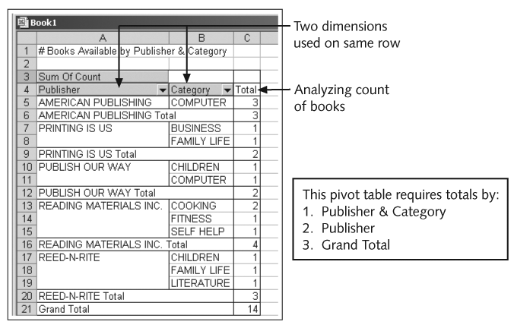
Excel Pivot Table Example
©2016. Cengage Learning. All rights reserved.

Slide 32
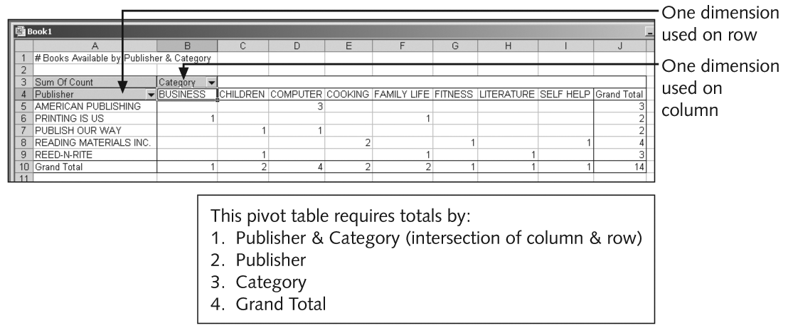
Excel Pivot Table Example (continued)
©2016. Cengage Learning. All rights reserved.

Slide 33
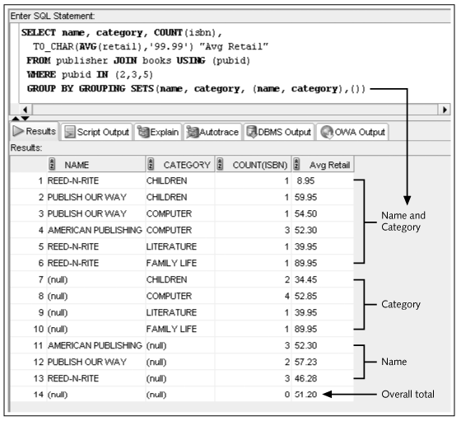
Grouping Sets

Slide 34
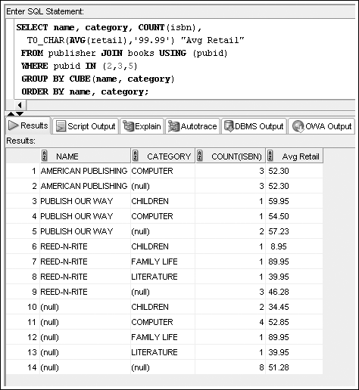
CUBE

Slide 35
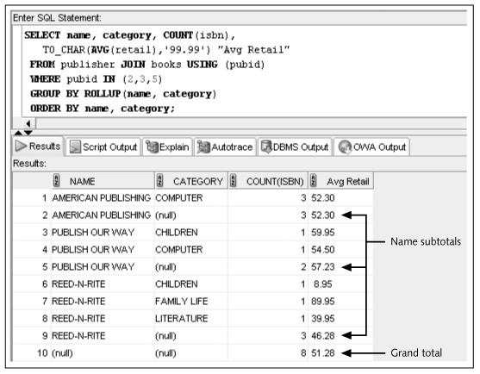
ROLLUP

Slide 36
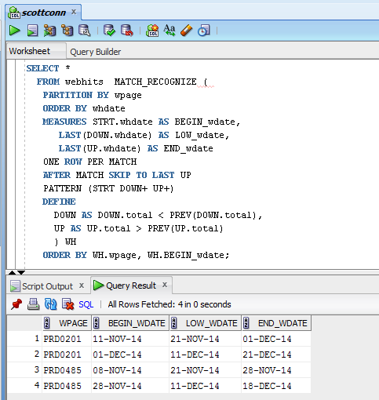
Pattern Matching
The MATCH_RECOGNIZE clause offers many options to identify the measures and patterns to analyze. It is an advanced query technique beyond the scope of this course, however, a brief example is provided to demonstrate the capabilities available through this mechanism.

Slide 37
Summary
The AVG, SUM, STDDEV, and VARIANCE functions are used only with numeric fields
The COUNT, MAX, and MIN functions can be applied to any datatype
The AVG, SUM, MAX, MIN, STDDEV, and VARIANCE functions all ignore NULL values
By default, the AVG, SUM, MAX, MIN, COUNT, STDDEV, and VARIANCE functions include duplicate values
©2016. Cengage Learning. All rights reserved.

Slide 38
Summary (continued)
The GROUP BY clause is used to divide table data into groups
If a SELECT clause contains both an individual field name and a group function, the field name must also be included in a GROUP BY clause
The HAVING clause is used to restrict groups in a group function
Group functions can be nested to a depth of only two. The inner function is always performed first, using the specified grouping. The results of the inner function are used as input for the outer function.
©2016. Cengage Learning. All rights reserved.

Slide 39
Summary (continued)
The STDDEV and VARIANCE functions are used to perform statistical analyses on a set of data
GROUPING SETS operations can be used to perform multiple GROUP BY aggregations with a single query
The CUBE extension of the GROUP BY calculates aggregations for all possible combinations or groupings of columns included
The ROLLUP extension of the GROUP BY calculates increasing levels of accumulated subtotals for the column list provided
Composite columns and concatenated groupings can be used in GROUPING SETS, CUBE, and ROLLUP operations
The GROUP_ID function helps eliminate duplicate grouping results
©2016. Cengage Learning. All rights reserved.

